Slide 1

Data-Driven Retention Strategy
Analyzing Employee Attrition & Enhancing Engagement for Junior Staff at Adecco India

Slide 2

Executive Summary
A comprehensive analysis of employee turnover across 4,410 staff records, highlighting key drivers and actionable interventions to retain junior talent.

Slide 3

Junior Attrition Rate
24.8%
Targeted Turnover Challenge
While Adecco India's overall company turnover stands at 16.1% (711 exits across 4,410 employees), attrition spikes to nearly 25% for junior-level roles (Job Level 1 and staff under age 30).
This localized attrition disrupts software project lifecycles, strains engineering sprints, and escalates recruitment and onboarding costs.
Junior Staff Turnover

Slide 4

Study Dataset & Scope
Merged Data Architecture: Unified demographic data, job survey results, manager feedback, and daily attendance logs across 4,410 employees.
Multi-Department Scope: Evaluation across Engineering, Sales, Marketing, and Customer Support divisions.
Time-Log Analytics: Net working hours derived from daily in-time and out-time timestamps to accurately quantify overtime fatigue.

Slide 5


Primary Drivers of Turnover
Overtime & Fatigue Burnout
Level 1 Growth Plateau
Employees averaging over 8.5 daily hours exhibit a 31.2% attrition rate, compared to 11.4% for those working standard hours. Junior tech staff face persistent crunch releases without compensatory time off.
Junior employees receiving low salary hikes (< 13%) leave at 22.5%. Furthermore, staff spending ≥ 2 years in Job Level 1 without promotion show a 29.1% attrition rate due to role stagnation.

Slide 6






Secondary Risk Factors
Manager Tenure
Travel Frequency
Work Environment
Attrition reaches 32.8% during the first 12 months under a direct manager, dropping to 11.2% once tenure exceeds 3 years.
Frequent client travel triggers a 24.9% turnover rate, whereas non-traveling roles maintain a low 8.0% attrition baseline.
Staff reporting low Environment Satisfaction (Score 1) register a 25.4% attrition rate due to team communication friction.

Slide 7
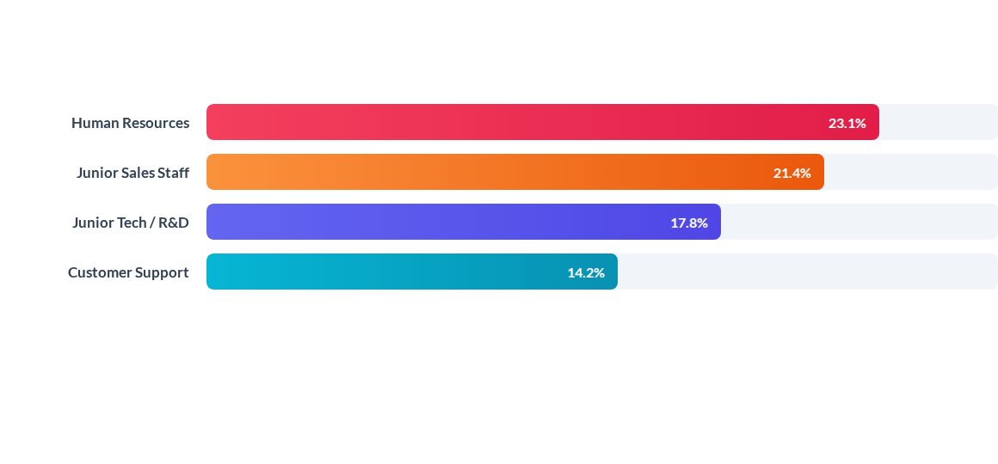
Attrition by Department
HR and Junior Sales/Tech roles represent the highest risk pools, requiring specialized intervention in career mapping and incentive restructuring.

Slide 8
Quantitative Risk Factors
Demographic / Metric | High-Risk Cohort | Attrition Rate | Risk Level
Marital Status & Age | Single, Age < 30 Years | 34.2% | Critical
Work-Life Balance | Rating = 1 (Poor Balance) | 33.1% | Critical
Daily Work Hours | > 8.5 Hours per Day | 31.2% | Critical
Manager Relationship | ≤ 1 Year with Manager | 32.8% | High
Compensation Hike | < 13% Salary Increase | 22.5% | Medium

Slide 9

Overtime & Burnout
Impact of Excessive Hours
Attendance logs reveal junior developers average 8.6 daily working hours. Chronic overtime during sprint cycles without mandatory recovery days leads to rapid disengagement.
Mitigating burnout through strict weekly workload caps represents the single largest operational opportunity to reduce attrition.

Slide 10




Strategic Action Plan
Q2 - Career Tracks
Q4 - Hybrid Work
Establish a transparent 18-month progression framework from Level 1 to Level 2.
Offer 2-3 remote days for employees commuting over 10 km to reduce travel fatigue.
Q1 - Workload Caps
Q3 - Mentorship
Institute 45h weekly overtime alarms and mandatory post-sprint rest days.
Mandate structured 30-60-90 day skip-level reviews and manager alignment KPIs.

Slide 11



Core Action Pillars
Workload Capping
Growth Mentorship
Hybrid Flexibility
Automated attendance alerts prevent developer burnout during crunch cycles.
Structured 1-on-1 career mapping to boost junior engagement and loyalty.
Flexible work schedules to offset long daily commutes and travel stress.

